Slide 1
Zack Glaser
zack@tech4lawyers.com
Memphis Bar Association: December 4th, 2019
Protecting Client Information on Personal Devices.

Slide 2
Client Data
Ethical Obligation
U.S. Border Crossing
Practical Solutions

Slide 3
Data Concepts
Client Data
Types of Data:
Complete Documents
Temporary Files
Ethical Obligation
Partial Files
Meta-Data
U.S. Border Crossing
Locations of Data:
Local Computer
Office Server
Practical Solutions
Email Server
Internet Infrastructure

Slide 4
Client Data & Information
Data Concepts
Types of Data:
Complete Documents
What Does Data Look Like?
Temporary Files
Partial Files
Meta-Data
Locations of Data:
Local Computer
Where is Data Located?
Office Server
Email Server
Internet Infrastructure

Slide 5
Client Data & Information
Data Concepts
What does Client Data look like?
Types of Data:
Complete Documents
Complete Files:
Temporary Files
MS Word; PDFs; Excel Spreadsheets; Photos, etc . . .
Partial Files
Temporary Files:
Meta-Data
Locations of Data:
.tmp File, Cookies, Internet Tokens
Partial or Deleted Files
Local Computer
Over-written, deleted, or corrupted files
Office Server
Meta-Data
Email Server
Internet Infrastructure
Author info, Timestamps, Location, etc . . .

Slide 6
Client Data & Information
Data Concepts
Where does this data exist?
Types of Data:
Complete Documents
Remote Locations:
Temporary Files
Remote Locations are places that you need to be connected to the internet in order to get to.
Partial Files
Meta-Data
Locations of Data:
Local Locations:
Local Computer
Local Locations are those places that you can access even when you are not connected to the internet at large.
Office Server
Email Server
Internet Infrastructure

Slide 7
Client Data & Information
Data Concepts
Remote Data: Data not physically on your device
Types of Data:
Complete Documents
Where is Remote Data Located?
Temporary Files
OneDrive
Webserver
Infrastructure
Partial Files
Meta-Data
DropBox
Data Server
Private Servers
Locations of Data:
Local Computer
Box
Email Server
Phone Servers
Office Server
Email Server
* These categories are not exclusive of each other.
Internet Infrastructure

Slide 8
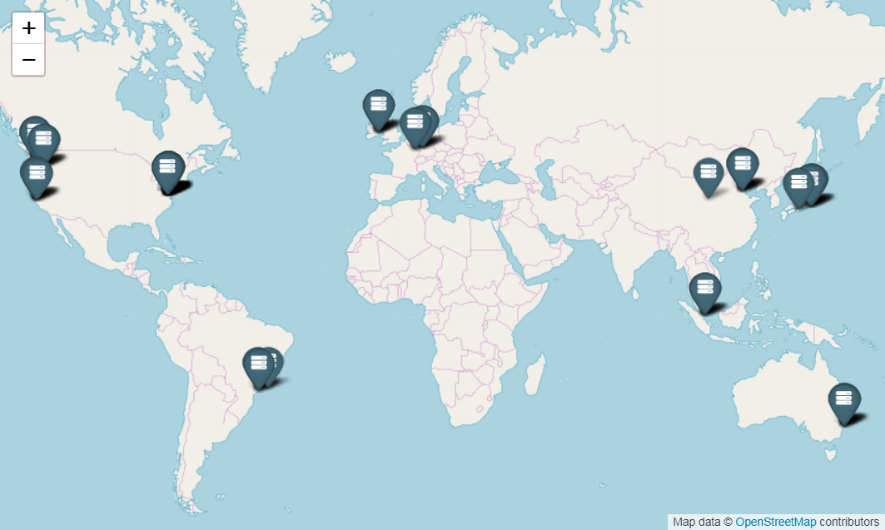
Client Data & Information
Data Concepts
Remote Data: Data Centers
Types of Data:
Amazon Web Services Data Centers
Complete Documents
Temporary Files
Partial Files
Meta-Data
Locations of Data:
Local Computer
Office Server
Email Server
Internet Infrastructure

Slide 9
Client Data & Information
Data Concepts
Local Data: Can access data without internet
Types of Data:
Complete Documents
Typical locations of Local Data
Temporary Files
Photos
Saved Texts
Documents
Partial Files
Meta-Data
Saved Email
Cache Folder
Temp Folders
Locations of Data:
Local Computer
Trash Folder
Downloads
Meta-Data
Office Server
Email Server
Internet Infrastructure

Slide 10
Relevant Rules
Client Data
TRPC: 1.6:
Confidentiality of Information
Ethical Obligation
TRPC: 1.15:
Protecting Client Property
U.S. Border Crossing
TRPC: 3.3:
Candor to Tribunal
TRPC: 4.1:
Truthfulness in Statements
Practical Solutions

Slide 11
Ethical Obligation
Relevant Rules
Balancing Client Information Security
TRPC: 1.6:
Confidentiality of Information
01
Make sure client data is not lost.
TRPC: 1.15:
Protecting Client Property
TRPC: 1.15:
Protecting Client Property
TRPC: 3.3:
Candor to Tribunal
02
Make sure client data is not exposed.
TRPC: 4.1:
Truthfulness in Statements
TRPC: 1.6:
Confidentiality of Information

Slide 12
Ethical Obligation
Relevant Rules
Confidentiality of Client Information
TRPC: 1.6:
Confidentiality of Information
Rule 1.6(d):
Unintentional Exposure of Client Information
TRPC: 1.15:
Protecting Client Property
Data Breaches, email sent to the wrong recipient, data left up on a public computer, etc . . .
TRPC: 3.3:
Candor to Tribunal
Rule 1.6(a), (b), & (c):
Intentional Exposure of Client Information
TRPC: 4.1:
Truthfulness in Statements
Releasing client data to an authorized third party, turning client information over to a tribunal, using client information to defend a malpractice suit, etc . . .

Slide 13
Ethical Obligation
Relevant Rules
Unintentional Breach of Confidentiality
TRPC: 1.6:
Confidentiality of Information
Rule 1.6(d):
“(d) A lawyer shall make reasonable efforts to prevent the inadvertent or unauthorized disclosure of, or unauthorized access to, information relating to the representation of a client.”
TRPC: 1.15:
Protecting Client Property
TRPC: 3.3:
Candor to Tribunal
Reasonable Efforts: Comment #18
“. . . Factors to be considered in determining the reasonableness of the lawyer's efforts include, but are not limited to, the sensitivity of the information, the likelihood of disclosure if additional safeguards are not employed, the cost of employing additional safeguards, the difficulty of implementing the safeguards, and the extent to which the safeguards adversely affect the lawyer's ability to represent clients (e.g., by making a device or important piece of software excessively difficult to use)
TRPC: 4.1:
Truthfulness in Statements

Slide 14
Ethical Obligation
Relevant Rules
Intentional Breach of Confidentiality
TRPC: 1.6:
Confidentiality of Information
Authorized:
Rule 1.6(a)(1) & (2):
Informed Consent
Impliedly Authorized
TRPC: 1.15:
Protecting Client Property
TRPC: 3.3:
Candor to Tribunal
Unauthorized:
Rule 1.6(a)(3):
Permitted by (b)
Lawyer reasonably believes is necessary to prevent some harm from happening.
Required by (c)
Lawyer must disclose in order to be truthful, or as required by other law.
TRPC: 4.1:
Truthfulness in Statements

Slide 15
Ethical Obligation
Relevant Rules
Intentional Breach of Confidentiality
TRPC: 1.6:
Confidentiality of Information
Rule 1.6(c):
“A lawyer shall reveal information relating to the representation of a client to the extent the lawyer reasonably believes disclosure is necessary . . .
TRPC: 1.15:
Protecting Client Property
to comply with an order of a tribunal requiring disclosure, but only if ordered to do so by the tribunal after the lawyer has asserted on behalf of the client all non-frivolous claims that the information sought by the tribunal is protected against disclosure by the attorney-client privilege or other applicable law; or
to comply with RPC 3.3 (Candor to Tribunal), 4.1 (Truthfulness in Statements), or other law.”
TRPC: 3.3:
Candor to Tribunal
TRPC: 4.1:
Truthfulness in Statements

Slide 16
Client Data
Ethical Obligation
U.S. Border Crossing
Practical Solutions

Slide 17
U.S. Border Crossing
What’s special about searches, or checks at U.S. Border Crossings?
Lowered Expectation of Privacy
Routine Searches are Considered Reasonable
Complete Access to Files
You’ve Got a Plane to Catch
Can Prepare for Potential Search

Slide 18
U.S. Border Crossing
What do you do if you get searched and you have client data with you?
Carry your Bar Card with you
Inform the Agent you are an attorney
Assert the privilege
Ask for a supervisor, or superior
Comply with the law

Slide 19
U.S. Border Crossing
How to Protect Your Client Files When Access is Assumed
1. Delete Data & Clean Device
2. Move Data off Device
3. Make A/C Privilege Easy to Assert

Slide 20
U.S. Border Crossing
What if your client data is compromised?
Inform each affected client
Wait for Bar Complaint

Slide 21
Helpful Tools
Ethical Obligation
Encryption Tools
VPNs
Client Data
Remote Filing
U.S. Border Crossing
Cleaning Tools
Secure Text
Practical Solutions
Alternatives to Text

Slide 22
Practical Solutions
Helpful Tools
What can we do to protect our clients?
Encryption Tools
VPNs
Limit Access to Machine or Device
Remote Filing
Limit Access to Specific File or Information
Cleaning Tools
Secure Text
Limit the Amount of Information on a Device
Alternatives to Text

Slide 23
Practical Solutions
Helpful Tools
Limiting Access to a Machine or Device
Encryption Tools:
Password Protect Your Device
BitLocker – Windows
FileVault - Mac
Create Users with Password Access
Barracuda - Email
Set Passcodes on Phones and Laptops
VPNs
Use Multi-Factor Authentication Where Possible
LogMeIn
Remote Wipe or Remote Encrypt
Splashtop
Remote Desktop - Windows
Prey; Intune
iCloud Remote Wipe

Slide 24
Practical Solutions
Helpful Tools
Limiting Access to Specific File or Info.
Encryption Tools:
Encrypt your Sensitive Folders
BitLocker – Windows
FileVault - Mac
BitLocker
FileVault
Barracuda - Email
Keep in mind that Encryption of Folders only protects from uncredentialled access
VPNs
Password Protect your Files
LogMeIn
In order to protect files from a bad actor who may have access to your files using your credentials, you should password protect individual files.
Splashtop
Remote Desktop - Windows
Protect Files in Transit (Internet)
Encrypt email that contains sensitive Client Data
Use a Virtual Private Network to access Client Files

Slide 25
Practical Solutions
Helpful Tools
Limit the Amount of Info on your Personal Devices
Remote Filing:
OneDrive
Centralized, Organized Filing System
Box
Create a filing system that works for you so that you:
Know where to protect, and
Know what locations you can delete files from.
Google Drive
DropBox
Back-up Files Remotely & Locally
iCloud
Create a back-up plan for your files and know where these are located. Ideally, you will have a Remote back-up and a Local back-up.
Cleaning Tools:
CCleaner – PC/Android
Systematically Clean Devices
iMyFone - iPhone
Have a plan for cleaning unwanted and unnecessary files and information off of your laptops, phones, and tablets. Use software like CCleaner to get the hard-to-reach places.
PhoneClean - iPhone

Slide 26
Practical Solutions
Helpful Tools
The Special Case of Text Messages
Secure Text:
WhatsApp?
Clients want to communicate with us via Text
iMessage
Although many of our clients communicate almost exclusively via text message, it is one of the most unsecure ways we can transfer information back and forth.
Confide
Signal
Do not share sensitive information via Text
Alternatives to Text:
Even if the Text is deleted from your phone, it still exists on your Phone Company’s server, or in other infrastructure locations.
Slack
Use a secure application if you must
Microsoft Teams
Google Messages
If text message is your only option, then use a secure text messaging app such as WhatsApp? when communicating with your client.

Slide 27
Conclusion
Helpful Tools
Cleaning Tools:
CCleaner – PC/Android
01
Know where your client information exists
iMyFone - iPhone
PhoneClean - iPhone
Encryption Tools:
02
Systematically clean your devices and encrypt files that cannot be cleaned.
BitLocker – Windows
FileVault - Mac
WhatsApp? – Text Messages
03
Periodically revisit your security practices.
VPNs
LogMeIn
Splashtop
Remote Desktop - Windows

Slide 28
Zack Glaser
zack@tech4lawyers.com
@tech4lawyers
@tech4lawyers
Ethical Obligations to Client Data at U.S. Border Crossings
@zack_glaser
(615) 810-0182

